Slide 1
Copyright Notice
These slides are distributed under the Creative Commons License.
DeepLearning.AI makes these slides available for educational purposes. You may not use or distribute these slides for commercial purposes. You may make copies of these slides and use or distribute them for educational purposes as long as you cite DeepLearning.AI as the source of the slides.
For the rest of the details of the license, see https://creativecommons.org/licenses/by-sa/2.0/legalcode

Slide 2




Decision Trees
Decision Tree Model

Slide 3









Cat classification example
Ear shape ^{(x}1 ⁾ | Face shape(x₂ ) | Whiskers (x₃ ) | Cat
Pointy | Round | Present | 1
Floppy | Not round | Present | 1
Floppy | Round | Absent | 0
Pointy | Not round | Present | 0
Pointy | Round | Present | 1
Pointy | Round | Absent | 1
Floppy | Not round | Absent | 0
Pointy | Round | Absent | 1
Floppy | Round | Absent | 0
Floppy | Round | Absent | 0
Categorical (discrete values)

Slide 4





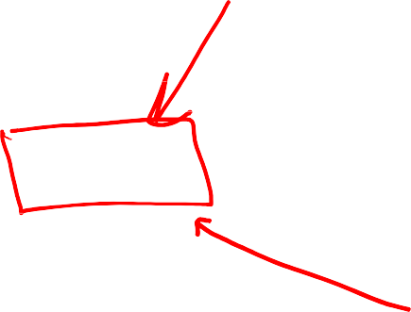



Decision Tree
New test example
root node
Ear shape
Pointy
Floppy
decision nodes
Face shape
Ear shape: Pointy Face shape: Round Whiskers: Present
Whiskers
Round
Not round
Present
Absent
Cat
Not cat
Cat
Not cat
leaf nodes

Slide 5
Decision Tree
Fac e
Fac e
shape
Ear shape
Ear
shape
shape
Pointy
Floppy
Pointy
Floppy
Round
Not round
Round
Not round
Cat
Not c at
Ear
shape
Not Cat
Not c at
Not cat
Whiskers
Fac e
shape
P res ent
A bs ent
Round
Not round
Pointy
Floppy
Cat
Not c at
Cat
Not Cat
Not Cat
Whis kers
P res ent
A bs ent
Cat
Not Cat

Slide 6
Decision Trees
Learning Process

Slide 7



Decision Tree Learning
?

Slide 8
Decision Tree Learning
Ear shape
Pointy
Floppy

Slide 9
Decision Tree Learning
Ear shape
Pointy
Floppy

Slide 10




Decision Tree Learning
Ear shape
Pointy
Floppy
?

Slide 11
Decision Tree Learning
Ear shape
Pointy
Floppy
Face shape
Round
Not round
4/4 cats

Slide 12


Decision Tree Learning
Ear shape
Pointy
Floppy
Face shape
Round
Not round
Cat
0/1 cats

Slide 13
Decision Tree Learning
Ear shape
Pointy
Floppy
Face shape
Round
Not round
Cat
Not cat

Slide 14
Decision Tree Learning
Ear shape
Pointy
Floppy
Face shape
?
Round
Not round
Cat
Not cat

Slide 15
Decision Tree Learning
Ear shape
Pointy
Floppy
Face shape
Whiskers
Round
Not round
Cat
Not cat

Slide 16
Decision Tree Learning
Ear shape
Pointy
Floppy
Face shape
Whiskers
Round
Not round
Present
Absent
Cat
Not cat
1/1 cats
0/4 cats

Slide 17
Decision Tree Learning
Ear shape
Pointy
Floppy
Face shape
Whiskers
Round
Not round
Present
Absent
Cat
Not cat
Cat
Not Cat

Slide 18

Decision Tree Learning
Decision 1: How to choose what feature to split on at each
node?
Maximize purity (or minimize impurity)

Slide 19



Decision Tree Learning
Decision 1: How to choose what feature to split on at each
node?
Maximize purity (or minimize impurity)
Cat
DN A
Yes
No
Ear shape
Fac e
Shape
Whis kers
Pointy
Floppy
Round
Not round
P res ent
A bs ent
5 /5 c ats
0 /5 c ats
4 /5 c ats
1 /5 c ats
4 /7 c ats
1 /3 c ats
3 /4 c ats
2 /6 c ats

Slide 20
Decision Tree Learning
Decision 2: When do you stop splitting?
Depth 0
When a node is 100% one class
When splitting a node will result in the tree exceeding
a maximum depth
Depth 1
Depth 2

Slide 21
Decision Tree Learning
Decision 2: When do you stop splitting?
Depth 0
When a node is 100% one class
When splitting a node will result in the tree exceeding
a maximum depth
Depth 1
Depth 2

Slide 22
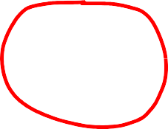
Decision Tree Learning
Decision 2: When do you stop splitting?
When a node is 100% one class
When splitting a node will result in the tree exceeding
a maximum depth
When improvements in purity score are below a
threshold
When number of examples in a node is below a threshold
Fac e Shape
Round
Not round
4 /7 c ats
1 /3 c ats

Slide 23
Decision Tree Learning
Decision 2: When do you stop splitting?
When a node is 100% one class
When splitting a node will result in the tree exceeding
a maximum depth
When improvements in purity score are below a
threshold
When number of examples in a node is below a threshold
Fac e Shape
Round
Not round
Not cat

Slide 24
Decision Tree Learning
Measuring purity

Slide 25

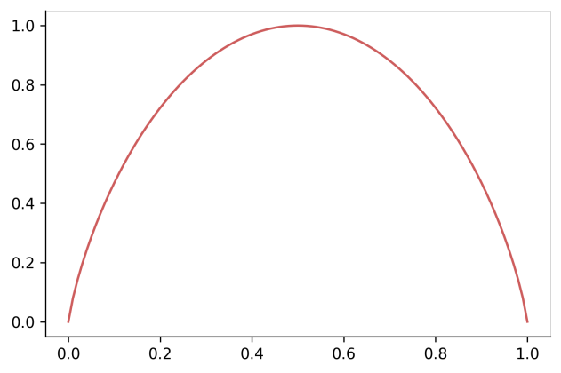

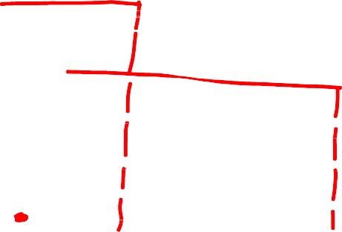



Entropy as a measure of impurity
p₁ = fraction of examples that
are cats
p₁ = 0 H(p₁) = 0
 | Dog | Dog | Dog | Dog | Dog | Dog
H(p₁) | Cat | Cat | Dog | Dog | Dog | Dog
p₁ = 2/6
H(p₁) = 0.92
p₁ = 3/6
H(p₁) = 1
Cat
Cat
Cat
Dog
Dog
Dog
p₁ = 5/6
H(p₁) = 0.65
Cat
Cat
Cat
Cat
Cat
Dog
p₁
p₁ = 6/6
H(p₁) = 0
Cat
Cat
Cat
Cat
Cat
Cat

Slide 26


Entropy as a measure of impurity
p₁ = fraction of examples that are cats
𝑝₀ = 1 − 𝑝₁
H(p₁)
𝐻(𝑝₁ ) = −𝑝₁𝑙𝑜𝑔₂(𝑝₁) − 𝑝₀𝑙𝑜𝑔₂(𝑝₀)
= −𝑝₁ 𝑙𝑜𝑔₂(𝑝₁) − (1 − 𝑝₁)𝑙𝑜𝑔₂(1 − 𝑝₁)
Note: “0 log(0)” = 0
p₁

Slide 27
Decision Tree Learning
Choosing a split: Information
Gain

Slide 28
Choosing a split
𝑝₁ = ⁵ൗ₁₀ = 0.5
𝐻 0.5 = 1
𝐻 0.5 = 1
Fac e
Shape
𝐻 0.5 = 1
Ear
shape
Whis kers
Pointy
Floppy
Round
Not round
P res ent
A bs ent
𝑝₁ = ⁴ൗ₅ = 0.8
𝐻 0.8 = 0.72
𝑝₁ = ¹ൗ₅ = 0.2
𝐻 0.2 = 0.72
𝑝₁ = ⁴ൗ₇ = 0.57
𝐻 0.57 = 0.99
𝑝₁ = ¹ൗ₃ = 0.33
𝐻 0.33 = 0.92
𝑝₁ = ³ൗ₄ = 0.75
𝐻 0.75 = 0.81
𝑝₁ = ²ൗ₆ = 0.33
𝐻 0.33 = 0.92
5 5
𝐻 0.5 − 𝐻 0.8 + 𝐻 0.2
10 10
7 3
₁₀ 𝐻 0.57 + ₁₀ 𝐻 0.33
4 6
𝐻 0.5 − ₁₀ 𝐻 0.75 + ₁₀ 𝐻 0.33
𝐻 0.5 −
= 0.28
= 0.03
= 0.12

Slide 29





Information Gain
_{𝑝}root _{= 5ൗ}
= 0.5
1
10
Ear shape
Pointy
Floppy
Information gain
_{𝑤}left _{𝐻}
_{𝑝}left
_{+ 𝑤}right _{𝐻}
_{𝑝}right
= H(p^{root}) −
1
1
1
$$p_{1}^{left}=4/5$$
$$p_{1}^{right}=1/5$$
$$W_{}^{left}=5/5$$
$$W_{}^{right}=5/5$$

Slide 30
Decision Tree Learning
Putting it together

Slide 31
Decision Tree Learning
Start with all examples at the root node
Calculate information gain for all possible features, and pick the one with
the highest information gain
Split dataset according to selected feature, and create left and right branches of the tree
Keep repeating splitting process until stopping criteria is met:
  When a node is 100% one class
  When splitting a node will result in the tree exceeding a maximum
depth
  Information gain from additional splits is less than threshold
  When number of examples in a node is below a threshold

Slide 32

Recursive splitting
?

Slide 33
Recursive splitting
Ear
shape

Slide 34
Recursive splitting
Ear
shape
Pointy
Floppy

Slide 35
Recursive splitting
Ear
shape
Pointy
Floppy

Slide 36
Recursive splitting
Ear
shape
Pointy
Floppy

Slide 37
Recursive splitting
Ear
shape
Pointy
Floppy
?

Slide 38
Recursive splitting
Ear
shape
Pointy
Floppy
Fac e
shape
Round
Not Round

Slide 39
Recursive splitting
Ear
shape
Pointy
Floppy
Fac e
shape
Round
Not Round

Slide 40
Recursive splitting
Ear
shape
Pointy
Floppy
Fac e
shape
Round
Not Round

Slide 41
Recursive splitting
Ear
shape
Pointy
Floppy
Fac e
shape
Round
Not Round
Cat

Slide 42
Recursive splitting
Ear
shape
Pointy
Floppy
Fac e
shape
Round
Not Round
Cat

Slide 43
Recursive splitting
Ear
shape
Pointy
Floppy
Fac e
shape
Round
Not Round
Cat
Not cat

Slide 44
Recursive splitting
Ear
shape
Pointy
Floppy
Fac e
shape
Round
Not Round
Cat
Not cat

Slide 45
Recursive splitting
Ear
shape
Pointy
Floppy
Fac e
shape
Round
Not Round
Cat
Not cat

Slide 46
Recursive splitting
Ear
shape
Pointy
Floppy
Fac e
shape
?
Round
Not Round
Cat
Not cat

Slide 47
Recursive splitting
Ear
shape
Pointy
Floppy
Fac e
shape
Whis kers
Round
Not Round
P res ent
A bs ent
Cat
Not cat

Slide 48
Recursive splitting
Ear
shape
Pointy
Floppy
Fac e
shape
Whis kers
Round
Not Round
P res ent
A bs ent
Cat
Not cat

Slide 49
Recursive splitting
Ear
shape
Pointy
Floppy
Fac e
shape
Whis kers
Round
Not Round
P res ent
A bs ent
Cat
Not cat

Slide 50
Recursive splitting
Ear
shape
Pointy
Floppy
Fac e
shape
Whis kers
Round
Not Round
P res ent
A bs ent
Cat
Not cat
Cat

Slide 51
Recursive splitting
Ear
shape
Pointy
Floppy
Fac e
shape
Whis kers
Round
Not Round
P res ent
A bs ent
Cat
Not cat
Cat

Slide 52
Recursive splitting
Ear
shape
Pointy
Floppy
Fac e
shape
Whis kers
Round
Not Round
P res ent
A bs ent
Cat
Not cat
Cat
Not cat

Slide 53

Recursive splitting
Ear
shape
Pointy
Floppy
Fac e
shape
Whis kers
Recursive algorithm
Round
Not Round
P res ent
A bs ent
Cat
Not cat
Cat
Not cat

Slide 54
Decision Tree Learning
Using one-hot encoding of categorical features

Slide 55

Features with three possible values
Ear shape (𝑥1) | Face shape (𝑥₂) | Whiskers ^{(𝑥}3⁾ | Cat (𝑦)
Pointy | Round | Present | 1
Oval | Not round | Present | 1
Oval | Round | Absent | 0
Pointy | Not round | Present | 0
Oval | Round | Present | 1
Pointy | Round | Absent | 1
Floppy | Not round | Absent | 0
Oval | Round | Absent | 1
Floppy | Round | Absent | 0
Floppy | Round | Absent | 0
Ear shape
Pointy
Floppy
Oval
3 possible values

Slide 56
One hot encoding
Ear shape | Pointy ears | Floppy ears | Oval ears | Face shape | Whiskers | Cat
Pointy |  |  |  | Round | Present | 1
Oval |  |  |  | Not round | Present | 1
Oval | 0 | 0 | 1 | Round | Absent | 0
Pointy | 1 | 0 | 0 | Not round | Present | 0
Oval | 0 | 0 | 1 | Round | Present | 1
Pointy | 1 | 0 | 0 | Round | Absent | 1
Floppy | 0 | 1 | 0 | Not round | Absent | 0
Oval | 0 | 0 | 1 | Round | Absent | 1
Floppy | 0 | 1 | 0 | Round | Absent | 0
Floppy | 0 | 1 | 0 | Round | Absent | 0

Slide 57
One hot encoding
If a categorical feature can take on 𝑘 values, create 𝑘 binary features (0 or 1 valued).

Slide 58


One hot encoding
Ear shape | Pointy ears | Floppy ears | Oval ears | Face shape | Whiskers | Cat
Pointy | 1 | 0 | 0 | Round | Present | 1
Oval | 0 | 0 | 1 | Not round | Present | 1
Oval | 0 | 0 | 1 | Round | Absent | 0
Pointy | 1 | 0 | 0 | Not round | Present | 0
Oval | 0 | 0 | 1 | Round | Present | 1
Pointy | 1 | 0 | 0 | Round | Absent | 1
Floppy | 0 | 1 | 0 | Not round | Absent | 0
Oval | 0 | 0 | 1 | Round | Absent | 1
Floppy | 0 | 1 | 0 | Round | Absent | 0
Floppy | 0 | 1 | 0 | Round | Absent | 0

Slide 59
One hot encoding and neural networks
Pointy ears |  | Floppy ears | Round ears | Face shape | Whiskers | Cat
1 |  | 0 | 0 | Round | Present | 1
 | 0 | 0 | 1 | Not round | Present | 1
 | 0 | 0 | 1 | Round | Absent | 0
 | 1 | 0 | 0 | Not round | Present 1 | 0
 | 0 | 0 | 1 | Round 1 | Present 1 | 1
 | 1 | 0 | 0 | Round 1 | Absent 0 | 1
 | 0 | 1 | 0 | Not round 0 | Absent 0 | 1
 | 0 | 0 | 1 | Round 1 | Absent 0 | 1
 | 0 | 1 | 0 | Round 1 | Absent 0 | 1
0 |  | 1 | 0 | Round 1 | Absent 0 | 1

Slide 60
Decision Tree Learning
Continuous valued features

Slide 61


Continuous features
Ear shape | Face shape | Whiskers | Weight (lbs.) | Cat
Pointy | Round | Present | 7.2 | 1
Floppy | Not round | Present | 8.8 | 1
Floppy | Round | Absent | 15 | 0
Pointy | Not round | Present | 9.2 | 0
Pointy | Round | Present | 8.4 | 1
Pointy | Round | Absent | 7.6 | 1
Floppy | Not round | Absent | 11 | 0
Pointy | Round | Absent | 10.2 | 1
Floppy | Round | Absent | 18 | 0
Floppy | Round | Absent | 20 | 0

Slide 62
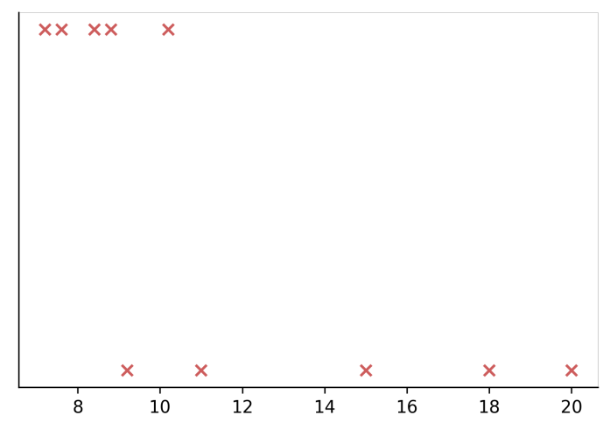
Splitting on a continuous variable
Cat
Weight ≤ 8 lbs .
Weight ≤ 9 lbs .
Yes
No
Not Cat
Weight (lbs.)
2 2
10 ^{𝐻} 2
4 4
10 ^{𝐻} 4
7 5
10 7
3
8
1
6
0
10 3
8
+ ₁₀ 𝐻
6
+ ₁₀ 𝐻
3
H(0.5) −
= 0.24
H(0.5) −
= 0.61
H(0.5) −
𝐻
+ 𝐻
= 0.40

Slide 63
Decision Tree Learning
Regression Trees (optional)

Slide 64
Regression with Decision Trees: Predicting a number
Ear shape | Face shape | Whiskers | Weight (lbs.
Pointy | Round | Present | 7.2
Floppy | Not round | Present | 8.8
Floppy | Round | Absent | 15
Pointy | Not round | Present | 9.2
Pointy | Round | Present | 8.4
Pointy | Round | Absent | 7.6
Floppy | Not round | Absent | 11
Pointy | Round | Absent | 10.2
Floppy | Round | Absent | 18
Floppy | Round | Absent | 20
)

Slide 65






Regression with Decision Trees
Ear
shape
Pointy
Floppy
Fac e
shape
Fac e
Shape
Round
Not Round
Round
Not round
Weights(lbs.):
7.2, 8.4, 7.6, 10.2
Weights(lbs.):
9.2
Weights (lbs.):
15, 18, 20
Weights(lbs.):
8.8,11

Slide 66

Choosing a split
Variance at root
node: 20.51
Variance at root
Variance at root node: 20.51
Ear shape
Fac e Shape
node: 20.51
Whis kers
Pointy
Floppy
Round
Not round
P res ent
A bs ent
Weights: 7.2,
9.2, 8.4,7.6, 10.2
Weights: 8.8, 15,
11, 18, 20
Variance: 21.87
Weights: 7.2, 15,
8.4, 7.6,10.2, 18, 20
Variance: 27.80
Weights: 8.8,9.2,11
Weights: 7.2, 8.8,
9.2, 8.4
Variance: 0.75
Weights: 15, 7.6,
11, 10.2, 18, 20
Variance: 1.47
Variance: 1.37
Variance: 23.32
_{𝑤}left ₌ 5_{ൗ10}
_{𝑤}right ₌ 5_{ൗ10}
_{𝑤}left ₌ 7_{ൗ10}
_{𝑤}right ₌ 3_{ൗ10}
_{𝑤}left ₌ 4_{ൗ10 𝑤}right ₌ 6_{ൗ10}
5 5
∗ 1.47 + ∗ 21.87
10 10
7 3
∗ 27.80 + ∗ 1.37
10 10
20.51 −
4 6
₁₀ ∗ 0.75 + ₁₀ ∗ 23.32
20.51 −
20.51 −
= 8.84
= 0.64
= 6.22

Slide 67
Tree ensembles
Using multiple decision trees

Slide 68





Trees are highly sensitive to small changes of the data
Ear
shape
Whis kers
Pointy
Floppy
P res ent
A bs ent

Slide 69

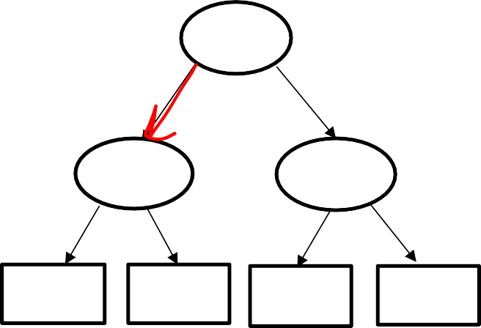





Tree ensemble
New test example
Whis kers
Ear
shape
Fac e shape
Ear shape: Pointy
Face shape: Not Round Whiskers: Present
P res ent
A bs ent
Floppy
Round
Not Round
Pointy
Ear
shape
Not c at
Cat
Face
shape
Whiskers
Whis kers
Pointy
Floppy
A bs ent
P res ent
A bs ent
Round
Not round
P res ent
Cat
Not c at
Cat
Not Cat
Not cat
Not Cat
Cat
Not Cat
Prediction: Cat
Prediction: Not cat
Prediction: Cat
Final prediction: Cat

Slide 70
Tree ensembles
Sampling with replacement

Slide 71




Sampling with replacement
Tokens
Sampling with replacement:

Slide 72


Sampling with replacement
Ear shape | Face shape | Whiskers | Cat
Pointy | Round | Present | 1
Floppy | Not round | Absent | 0
Pointy | Round | Absent | 1
Pointy | Not round | Present | 0
Floppy | Not round | Absent | 0
Pointy | Round | Absent | 1
Pointy | Round | Present | 1
Floppy | Not round | Present | 1
Floppy | Round | Absent | 0
Pointy | Round | Absent | 1

Slide 73
Tree ensembles
Random forest algorithm

Slide 74

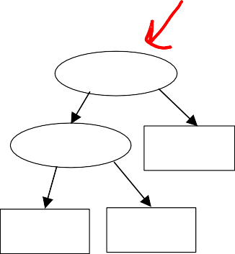
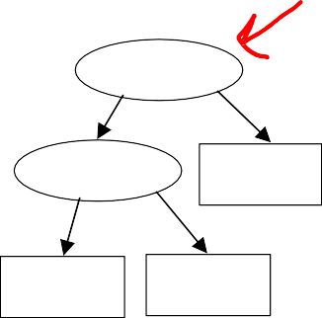
Generating a tree sample
Given training set of size 𝑚
For 𝑏 = 1 to 𝐵:
Use sampling with replacement to create a new training set of size 𝑚
Train a decision tree on the new dataset
Ear
shape
Pointy Floppy Floppy Pointy Pointy Floppy Floppy Pointy Pointy Pointy
Face
shape
Round Round Round Round
Not Round
Round
Round
Not Round Not Round Not Round
Whiskers
Ear
shape
Pointy Pointy Floppy Floppy Pointy Floppy Floppy Floppy Pointy Pointy
Face
shape
Round
Round Not Round Not Round
Round
Round Round Round
Not Round
Round
Whiskers
Cat
Yes Yes No No Yes No No No No Yes
Ear shape
Whiskers
Present Absent Absent Present Present Absent Present Absent Absent Present
Cat
Present
Absent
Pointy
Floppy
Yes No No Yes Yes No Yes No No Yes
Present Absent Absent Absent Absent Absent Absent Absent Absent Present
Face
shape
…
Ear shape
Not cat
Not cat
Round
Not round
Round
Not round
Cat
Not cat
Cat
Not cat
Bagged decision tree

Slide 75

Randomizing the feature choice
At each node, when choosing a feature to use to split,
if 𝑛 features are available, pick a random subset of
𝑘 < 𝑛 features and allow the algorithm to only choose
from that subset of features.
Random forest algorithm

Slide 76
Conclusion
When to use decision trees

Slide 77
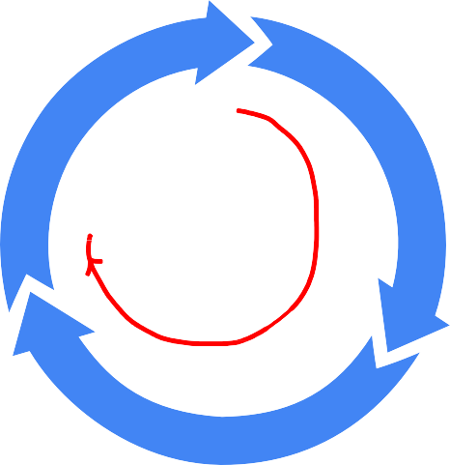

Decision Trees vs Neural Networks
Decision Trees and Tree ensembles
Works well on tabular (structured) data
Not recommended for unstructured data (images, audio, text)
Fast
Choose architecture (model, data, etc.)
Diagnostics
(bias, variance and error
analysis)
Train model

Slide 78
Decision Trees vs Neural Networks
Decision Trees and Tree ensembles
Works well on tabular (structured) data
Not recommended for unstructured data (images, audio, text)
Fast
Small decision trees may be human interpretable
Neural Networks
Works well on all types of data, including tabular (structured) and
unstructured data
May be slower than a decision tree
Works with transfer learning
When building a system of multiple models working together, it might be easier to string together multiple neural networks

